Slide 1


Rental House Finding System
Presentation
RFH Team
Supervisor: Mr. Phan Trường Lâm
Nguyễn Việt Nam – 01595
Cao Quốc Hưng – 01766
Võ Hoàng Việt – 01388
Trần Thị Bích – 01501
Nguyễn Tiến Chung - 01726

Slide 2
Contents
1. Introduction
Project Management
Requirement Specifications
Design Description
Test Documentation
Summary
Demo
Q&A

Slide 3
PART 1: INTRODUCTION
1.1 Background
1.2 Literature Review
1.3 Our Proposal & Products

Slide 4
PART 1: INTRODUCTION
1.1 Background
Nowadays, the need of finding house for lease is increased really fast, especially, in big cities.
Renter spends lots of time for asking friends or going to somewhere to find a suitable house for lease.
House owner needs much money, time and effort to advertise their properties

Slide 5
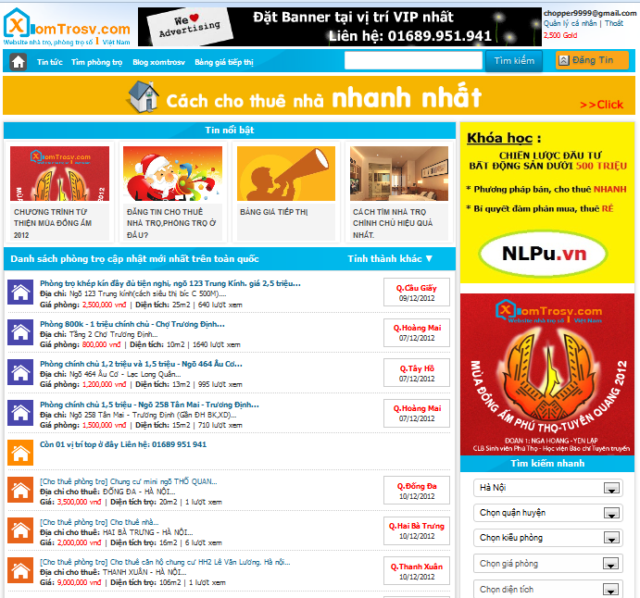
PART 1: INTRODUCTION
1.2 Literature Review
In overview, this website has supported users quite well with many general features of a standard advertisement website; however:
- Website does not have comparing between similar topics.
- It does not have view history and save favorites function.
- It supports Google map but with limitation function implemented on this.

Slide 6
PART 1: INTRODUCTION
1.2 Literature Review
In overview, this website has supported users quite well with many general features of a standard advertisement website; however:
- Website does not have comparing between similar topics.
- It does not have view history and save favorites function.
- It supports Google map but with limitation function implemented on this.

Slide 7
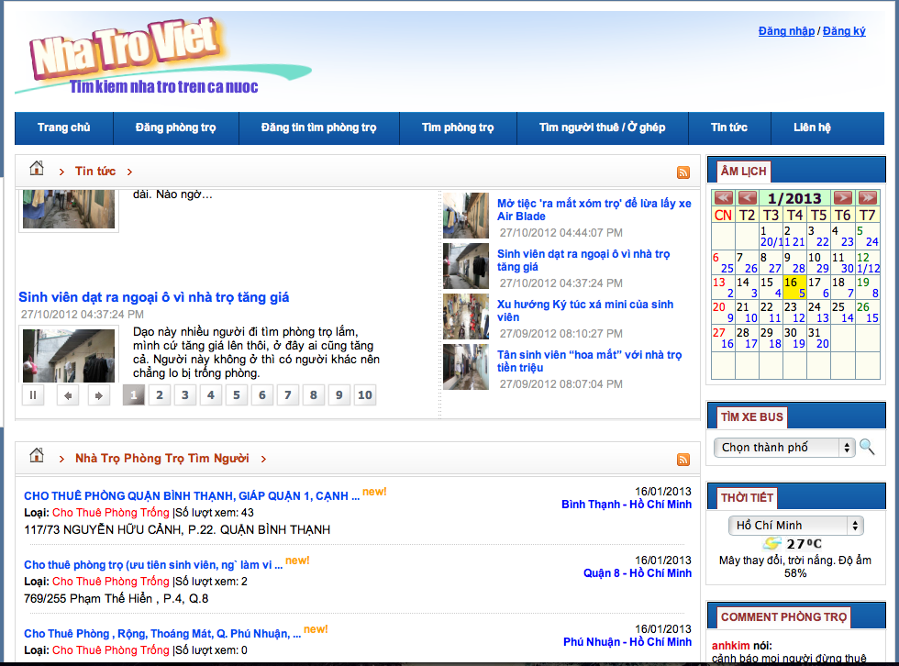
PART 1: INTRODUCTION
1.2 Literature Review
Each post has enough information
Suggestion shows rooms on the same district.
Provide more related information that user may need
No bookmark and rating
Google Map implementation has bug
Suggestion doesn’t show rooms on the same district, which helps users compare among candidate selections.

Slide 8
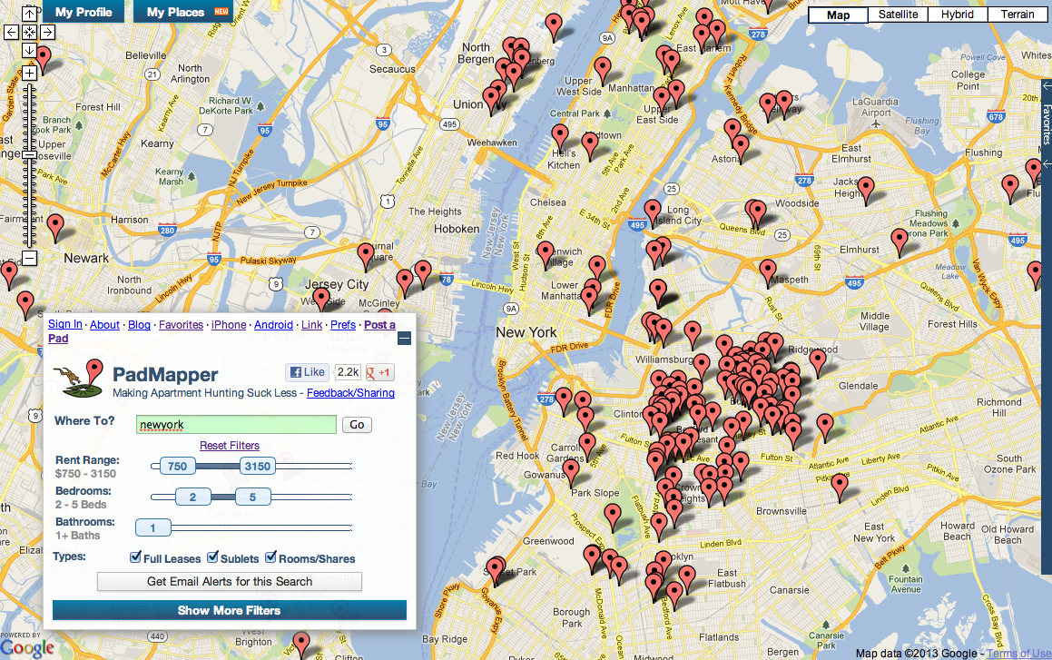
PART 1: INTRODUCTION
1.2 Literature Review
It has visual interaction
Favorite list for users to refer later.
No comparison function between 2 or more positions.
No suggestion for other places near selected positions such as universities, markets, and hospitals…

Slide 9
PART 1: INTRODUCTION
1.3 Our Proposal
Quick search function: should be faster, more efficient with suggestion of good and suitable houses, flats for users
Advanced Search: : should be faster, more efficient with suggestion of good and suitable houses, flats for users

Slide 10
PART 1: INTRODUCTION
1.3 Our Proposal
Visualization: Improve the interaction between users and visual maps in friendly & direct ways.
Simple flows of interaction: Improve the interaction between users and visual maps in friendly & direct ways.

Slide 11
PART 2: SOFTWARE PROJECT MANAGEMENT
2.1 Development Environment
2.2 Process
2.3 Project Planning

Slide 12


PART 2: SOFTWARE PROJECT MANAGEMENT
2.1 Development Environment
Development Hardware
2 Gb of RAM,
50 Gb of hard disk
Pentium dual core 2.0 GHz.
Server Hardware
2 Gb of RAM
50Gb of hard disk
Core 2 Duo 2.0 GHz

Slide 13



PART 2: SOFTWARE PROJECT MANAGEMENT
2.1 Development Environment
Framework :
Environment :
Web Server:

Slide 14






PART 2: SOFTWARE PROJECT MANAGEMENT
2.1 Development Environment
Source Control:
Operating system:
DBMS:
API:

Slide 15
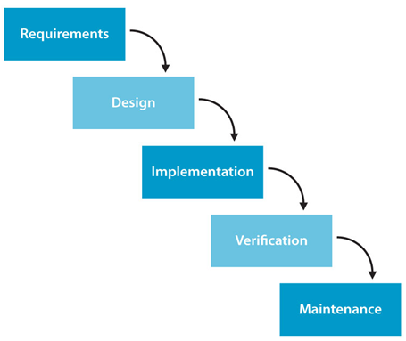
PART 2: SOFTWARE PROJECT MANAGEMENT
2.2 Process
Waterfall model

Slide 16
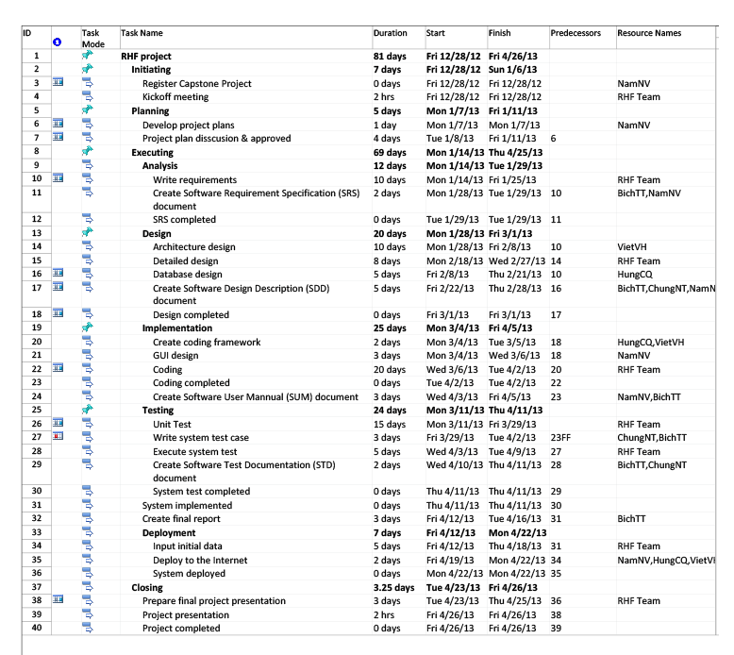
PART 2: SOFTWARE PROJECT MANAGEMENT
2.2 Project Planning

Slide 17
Part 3: System Requirement Specifications
User Requirements
System Requirements
Non-functional requirements*

Slide 18


User requirements
Visitor
Registered User
Administration

Slide 19
User Requirements – Visitor
Create a new account
Search for post
Create ,edit , renew & delete post
View post
View, upload images posts

Slide 20
User Requirements – Registered Users
Login Log out
Change User profile
Reset , Change password
Manage Post, Payment, Favorite
Add , remove Favorite post
Report post
Use All Function of Visitor

Slide 21
User Requirements – Admin
Manage Categories
Manage Reports post
Manage Posts
Manage Bad Post
Manage Provinces
Manage Districts

Slide 22
User Requirements – Admin
Manage Locations
Manage Post Status
Manage Roles
Manage Payment
Manage Bad Words
Manage Bad Word Types
Manage Configuration
Use all functions in the system

Slide 23
System Requirement Specification
Auto hide the post after x days posted
Auto send sms to user to notification
about the topic had Expire

Slide 24
System Requirement Specification
Manage Locations
Manage Post Status
Manage Roles
Manage Payment
Manage Bad Words
Manage Bad Word Types
Manage Configuration
Use all functions in the system

Slide 25
System Requirement Specification
Non-Functional Requirement
Reliability
Availability
Security
Maintainability
Portability
Performance

Slide 26
PART 4: SOFTWARE DESIGN DESCRIPTION
2.1 Architecture Design
2.2 Detailed Design
2.3 Database Design

Slide 27
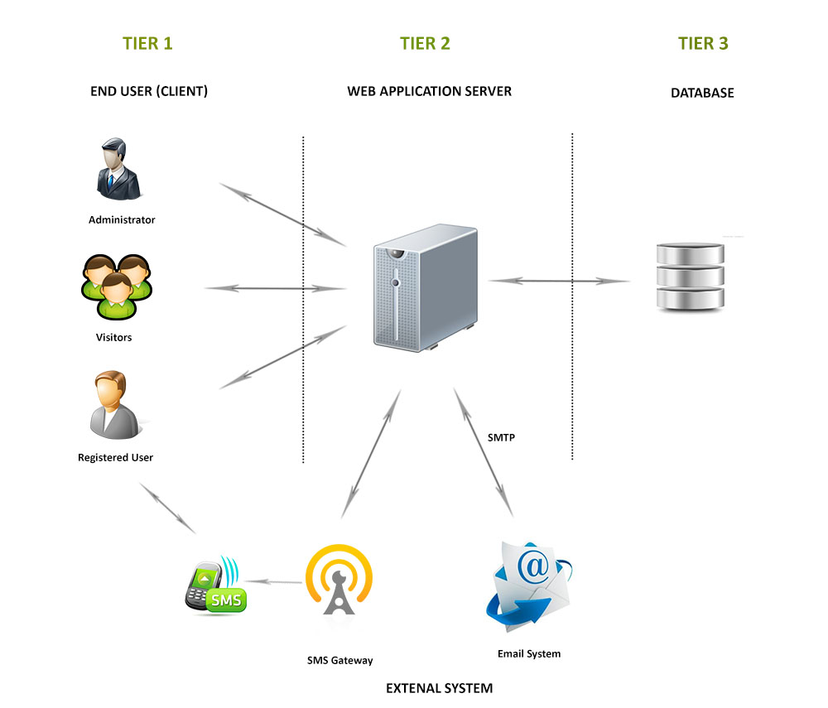
Part 4: Software Design Description
1
Architectural design

Slide 28
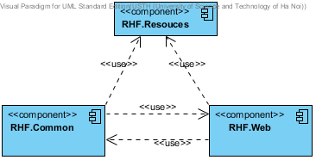
Part 4: Software Design Description
2
Detailed design
Component diagram

Slide 29
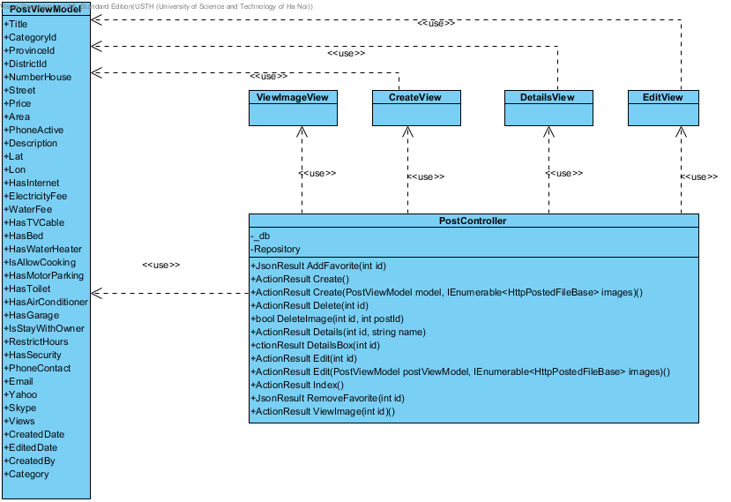
Part 4: Software Design Description
2
Detailed design
PostController-Class diagram

Slide 30
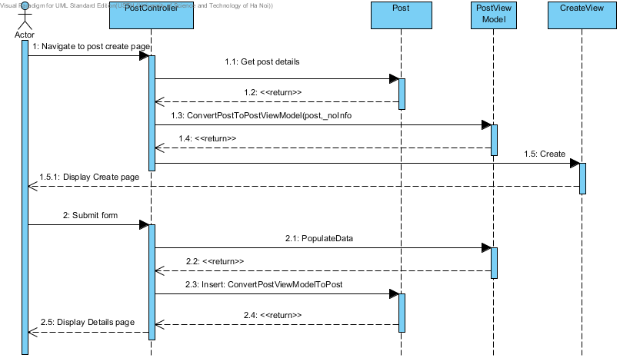
Part 4: Software Design Description
2
Detailed design
CreatePost-Sequence diagram

Slide 31
Part 4: Software Design Description
3
Database design
3

Slide 32
Part 5: Software Test Documentation
1
Unit Testing
2
Integration Testing
3
System Testing

Slide 33
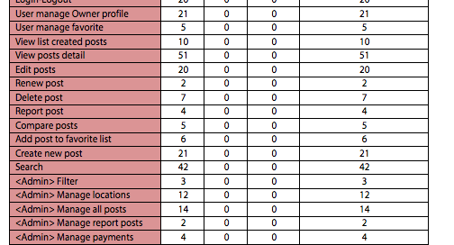
Test result:
Part 5: Software Test Documentation

Slide 34
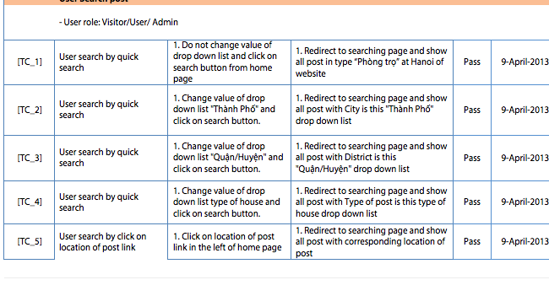
Test Logs
Part 5: Software Test Documentation

Slide 35
Part 6: Summary
Capstone Project: completed
Continue developing
Deploy to http://www.5house.us/

Slide 36
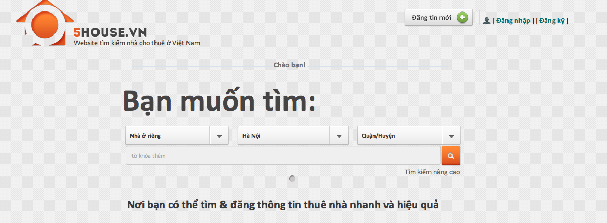
Part 7: Demo - Q&A

Slide 37


